Slide 1

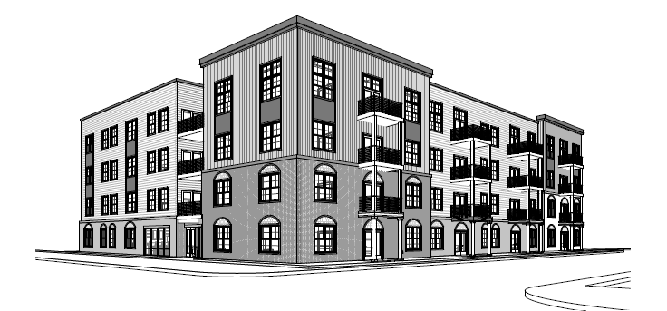

THE CENTRAL OHIO COMMUNITY LAND TRUST (COCLT) IS A SUBSIDIARY OF THE CENTRAL OHIO COMMUNITY IMPROVEMENT CORPORATION (COCIC)–THE FRANKLIN COUNTY LAND BANK

Slide 2

Central Ohio Community Improvement Corporation
ABOUT US:
  The mission of COCIC is to spark community stabilization in neighborhoods throughout Franklin County by returning properties to productivity.
WHAT:
  COCIC is a private, non-profit organization, formed by the Franklin County Board of Commissioners, to acquire and improve unproductive property across the county.
HOW:
  Operating as a county land bank, COCIC works to return unproductive
  properties to contributing, tax-paying status, increasing
  property values and generating new housing and business
  opportunities for local communities.
WHY:
  Improving the quality of our neighborhoods improves the
  circumstances of the individuals, families and businesses
  who reside there.

Slide 3

PROJECT OVERVIEW
The Central Ohio Community Land Trust (COCLT) is pleased to provide you with an update on our The Flats @ Broad and Gould Project. With support from the City of Columbus, the Land Trust is constructing twenty-three (23) condominium units. The project features multiple two and three-bedroom units with modern designs that accent the current neighborhood. The Land Trust has been building affordable homes in the area since 2021 and has completed and sold over 200 homes to date. This is our second condo development.

Slide 4
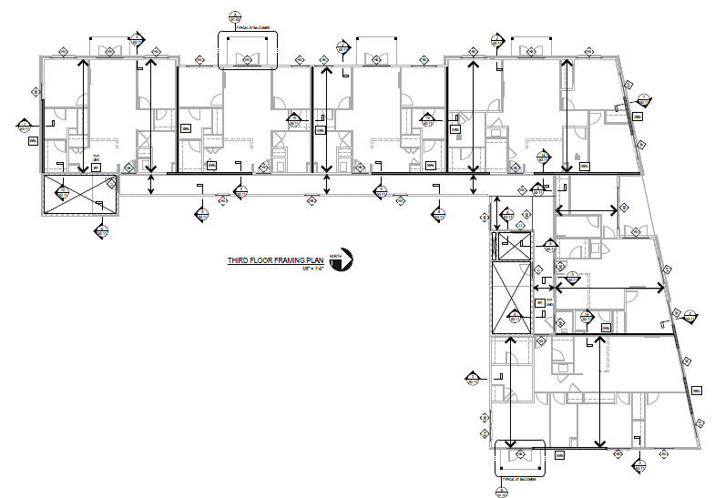
Project Importance / Amenities
The Flats at Broad and Gould represents an investment to bring more affordable housing options to County and City residents,. The project is the construction of a four-story structure with over twenty condominium units for sale that range from 950 – 1300 square feet, 2-3 Bedrooms, 3 bath with 1st level parking.

Slide 5
PROGRAM GUIDELINES:
At the time a Questionnaire is returned and until the time of closing,
Buyer must be a Franklin County resident.
Buyer must be 18 years or older.
Neither Buyer nor Buyer’s spouse, if applicable, can own a home or have an ownership interest in a residential or commercial structure, rental property, or land (vacant or occupied) used for residential or commercial purposes.
Buyer cannot be listed on a mortgage as a mortgagor.

Slide 6
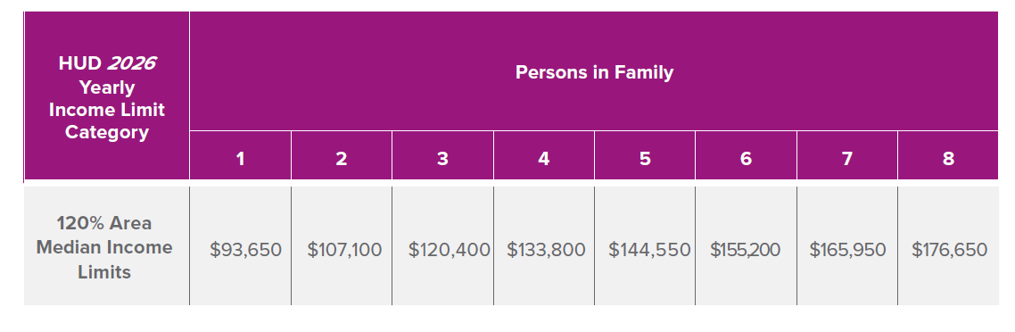
What are the Income Qualifications?
This chart tells you what your HUD income limits are and determines your eligibility for a COCLT home. It is based on:
1. The number of people in your family
2. The gross income your family makes each year
Based on the Office of Housing and Urban Development (HUD) Income Guidelines

Slide 7


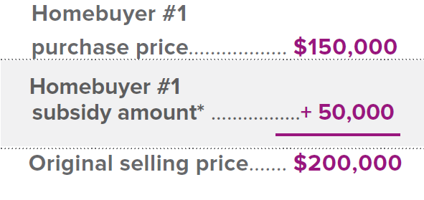
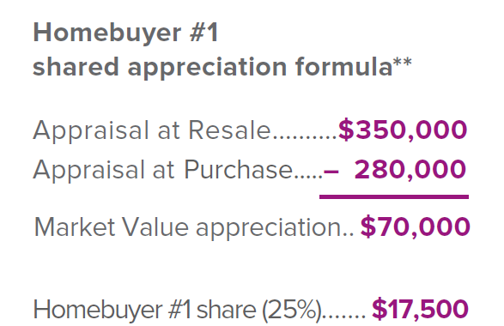
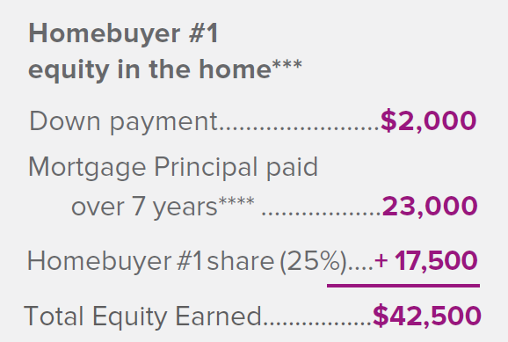

RESALE MODEL and EQUITY – EXAMPLE

Slide 8

Norman Deena,
Program Coordinator/Homebuyer Advocate
The Land Bank Center
845 Parsons Avenue
Columbus, Ohio 43206
D 614.724.4940
O 614.724.LAND (5263)
E norman.deena@cocic.org

